Slide 1
JIBEBE MECHANICAL WEEK 11

Slide 2
TASKS DONE
1. Steering installation
Acquisition of 90 degrees universal joints to replace the 7 degree joints
2. Acquisition of kasenit compound is in progre\

Slide 3
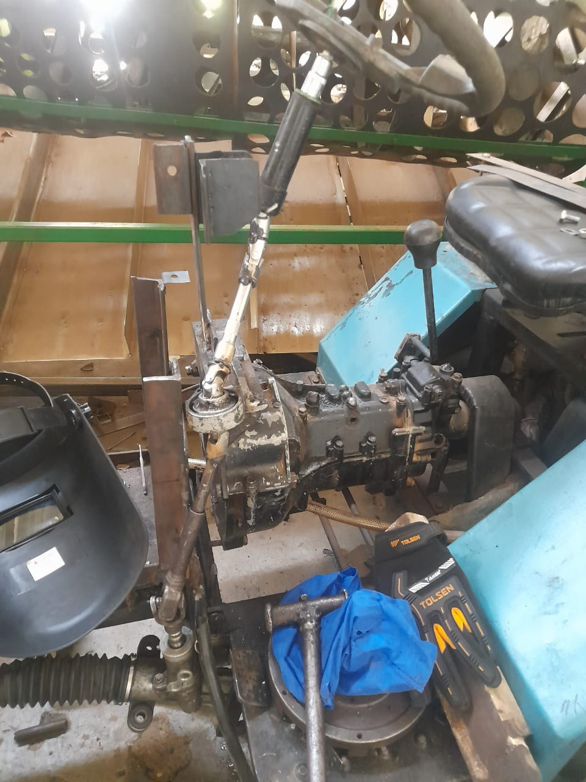
DEMO OF STEERING
SYSTEM
This is the steering system created using the new universal joints
The previous ones had a maximum tilt angle of 7 degrees thus creating a challenge in the fabrication
They were also heavier and wider which brought about a challenge as the space was limited
We researched and settled on using 90 degrees universal joints that can be created by joining two universal joints used with the box spanners.

Slide 4
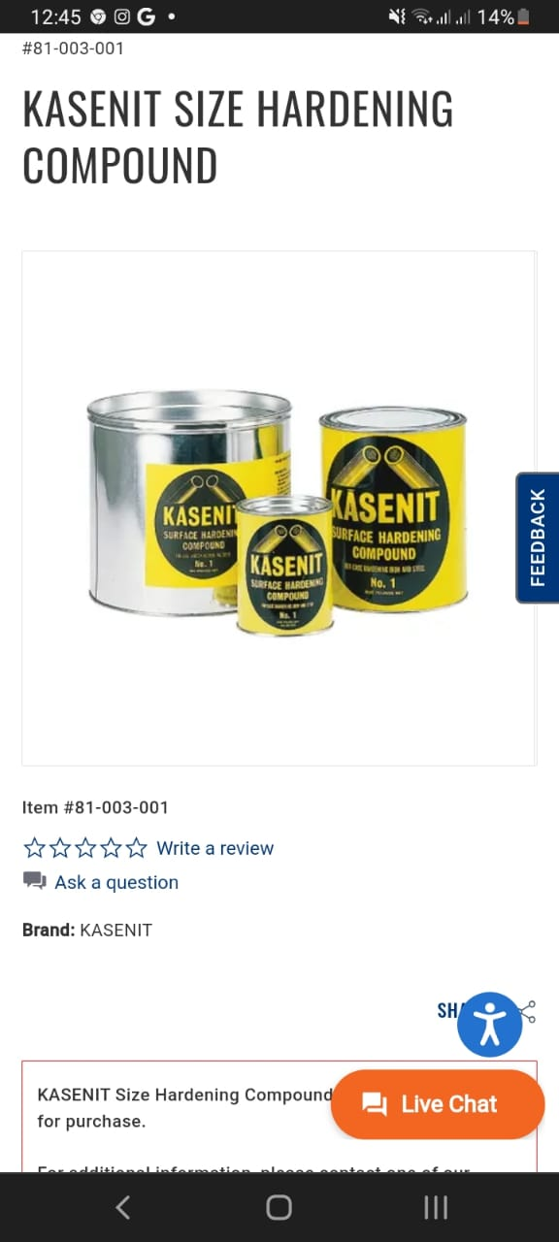
KASENIT
This is the compound we are being advised to use to harden our motor coupling and key

Slide 5
TO DO
Acquisition of the hardening compound
Acquisition of the special rods used to weld stainless steel
Completion of the steering system fabrication
Hardening of the motor-flywheel coupling

Slide 6
THANK YOU
😀

